Slide 1
Digital Portfolio
STUDENT NAME: Hemavathi. S
REGISTER NO AND NMID: 222409713 &
DEPARTMENT: B.Sc. Computer Science
COLLEGE:Government arts and science college perumbakkam / Madras University

Slide 2
PROJECT TITLE
Scenery Portfolio Front And Development

Slide 3


AGENDA
Problem Statement
Project Overview
End Users
Tools and Technologies
Portfolio design and Layout
Features and Functionality
Results and Screenshots
Conclusion
GitHub Link
3/21/2024 Annual Review

Slide 4

PROBLEM STATEMENT
In today’s fast-paced lifestyle, people prefer ordering food online for convenience. However, many local restaurants still lack a proper digital platform to manage customer orders, leading to miscommunication, delays, and loss of customers. To address this issue, the project “Online Food Ordering System” focuses on developing a simple, user-friendly web application that allows customers to browse menus, place orders, and track delivery status using HTML, CSS, JavaScript, and a backend database.

Slide 5

PROJECT OVERVIEW
The Online Food Ordering System is a web-based project designed to simplify the process of ordering food from restaurants. The system allows users to register, browse menus, add items to a cart, and place orders online. Restaurants can manage orders and update menu items dynamically. The project demonstrates the integration of front-end (HTML, CSS, JavaScript) with a backend (PHP/MySQL) to create a complete food ordering experience.

Slide 6

WHO ARE THE END USERS?
Customers – who can order food conveniently online.
Restaurant Owners – who can manage orders and update menus easily.
Delivery Staff – who can track and deliver orders efficiently.
Students & Beginners – who can learn full-stack development through this project.

Slide 7

TOOLS AND TECHNIQUES
HTML5 & CSS3 – for creating the structure and styling of the website.
JavaScript – for interactivity and dynamic updates.
PHP – for backend server-side programming.
MySQL – for database management of users, menus, and orders.

Slide 8
POTFOLIO DESIGN AND LAYOUT
The portfolio design and layout project is created with a focus on simplicity, creativity, and professional presentation. The website is divided into structured sections that allow easy navigation and showcase the developer’s skills. It highlights both visual design and information clarity, making it suitable for personal branding Header Section → Contains the portfolio owner’s name/logo with a clean navigation menu
About Section → Brief introduction about the person, purpose, and career goals.
Skills Section → Displays technical and soft skills using progress bars or icons
Projects Section → Showcases completed works with descriptions and links.
Resume Section → Downloadable CV/resume for recruiters
Contact Section → Form or links to connect via email and social media.
8

Slide 9
FEATURES AND FUNCTIONALITY
Attractive Visual Design – Responsive layout with modern colors, typography, and icons.
Interactive Navigation – Smooth scrolling and menus for better user experience.
Project Showcase – Dedicated section to highlight major projects with screenshots.
Responsive Layout – Works on desktop, tablet, and mobile devices.
Animations & Effects – Subtle CSS/JS animations for buttons, hover effects, and transitions.

Slide 10
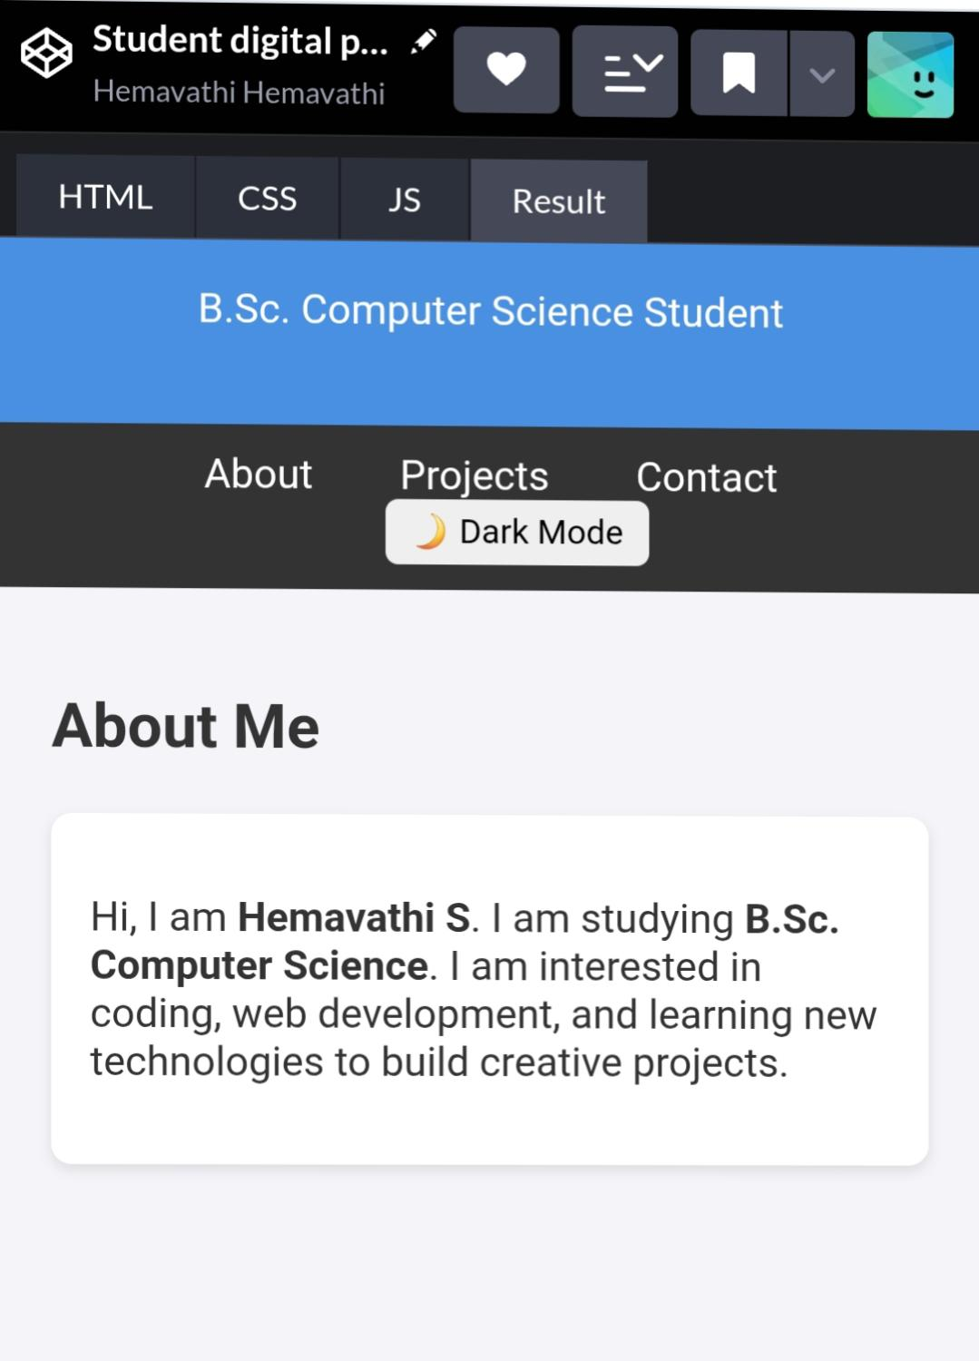
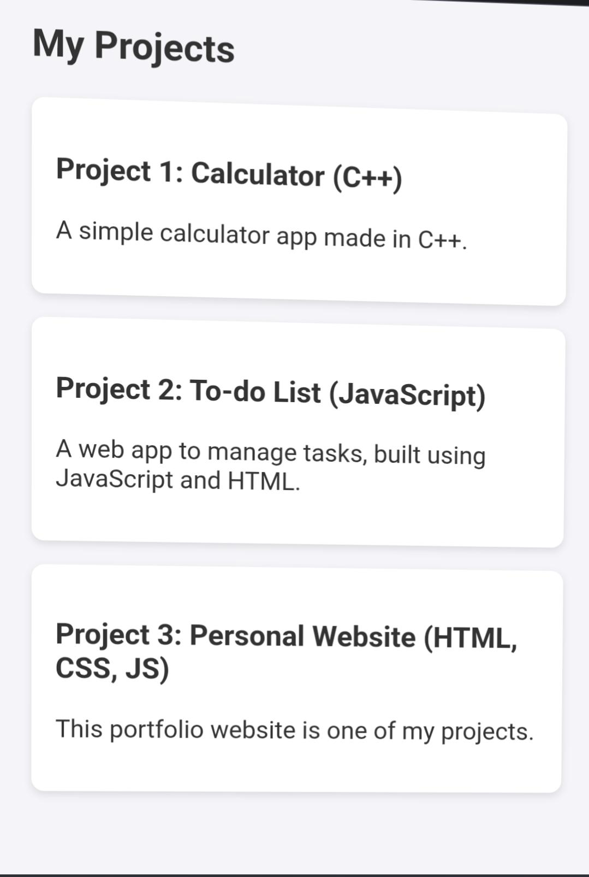

RESULTS AND SCREENSHOTS
3/21/2024 Annual Review
10

Slide 11
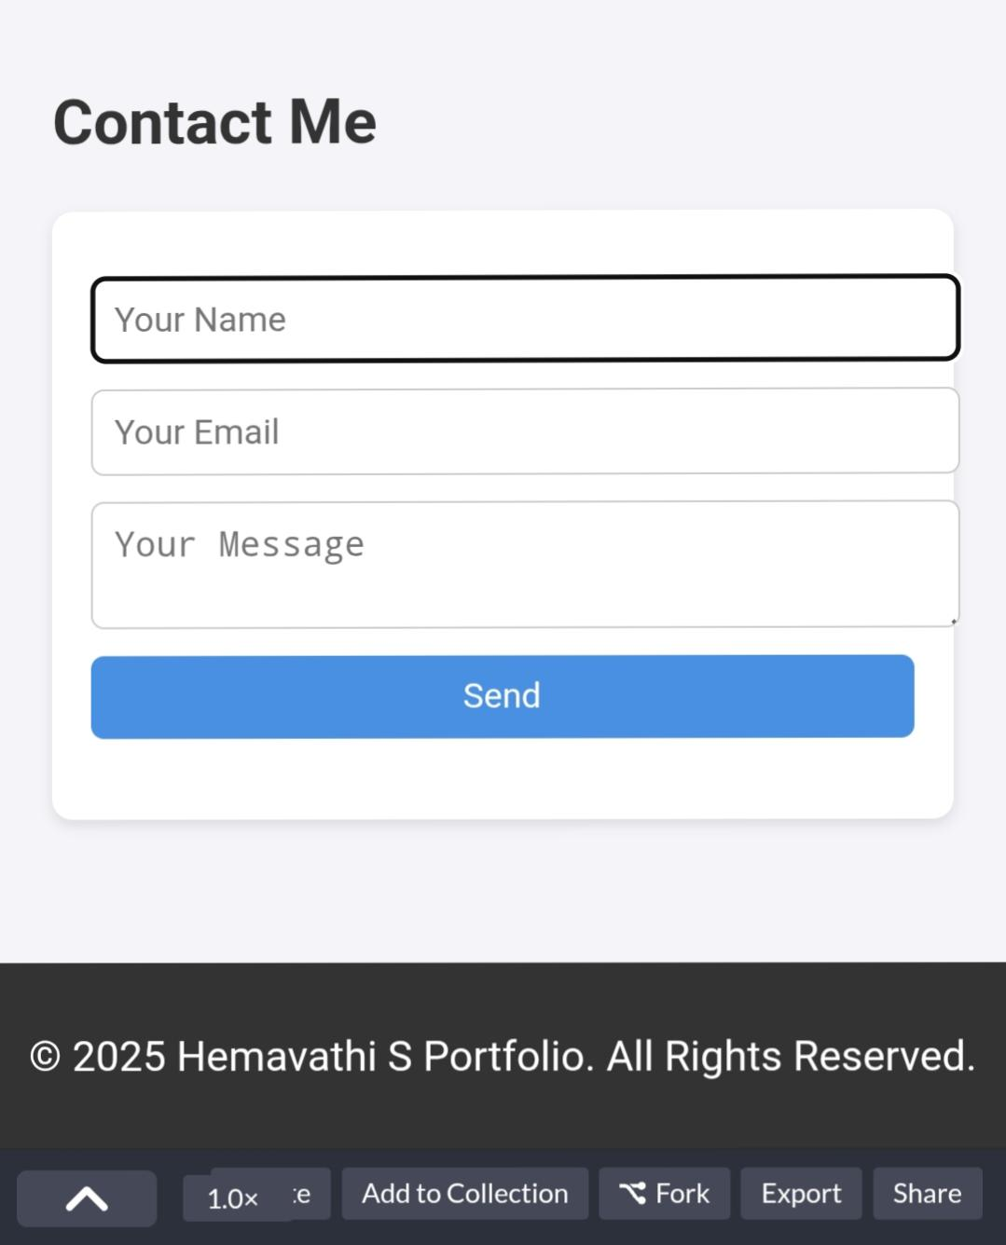
RESULT AND SCREENSHOT

Slide 12
CONCLUSION
The Portfolio Design and Layout Project demonstrates how creativity and technical skills can be combined to build a professional and visually appealing portfolio website. It highlights the importance of personal branding, user-friendly design, and responsive layouts in today’s digital world.
Through this project, beginners gain hands-on experience with HTML, CSS, and JavaScript, while also learning how to present their skills and projects effectively. The final portfolio serves as a digital resume that can attract recruiters, showcase achievements, and create a strong online presence.
✨ In short, this project not only enhances web development skills but also provides a valuable platform for career growth and opportunities.
12

